Slide 1
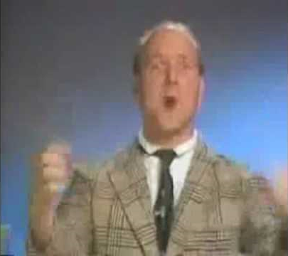
Group 822: SemiSuperReversi
Can you believe it?

Slide 2
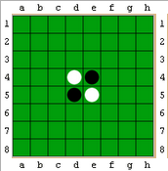
Reversi: the rules
Starting position
A maker must be placed in line (horizontal, vertical & diagonal) between players own colour and at least one of the opponents colour
Placed as in 1) will make the opponents marker(s) turn to the players colour
Dark player starts – thereafter players will take alternating turns
If a player cannot place a marker the turn will pass to the other player
When none of the players can move the game is finished

Slide 3
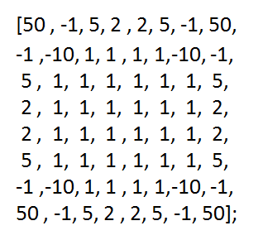
Evaluation function
Version 0.1: Finds numbers of markers in n+? compared to n
Version 0.2:

Slide 4
Negamax
Minimax
Improvement of minimaxing (two players and zero-sum game)
Implementation is simpler

Slide 5
Negamax flowchart (First ever recursive flowchart)
Is gameOver() or maxDepth reached.
Yes
Make newBoard from move
Return evaluation for move
No
Find tree under newBoard with currentDepth+1
Get possible moves and run for each move.
currentDepth-1
Set currentScore to negative of recursiveScore.
If currentScore > bestScore:
store bestScore and bestMove

Slide 6
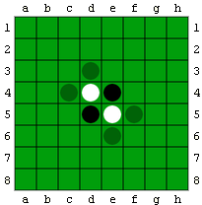

Example
d3
c4
e6
f5

Slide 7
Alpha-Beta Pruning
Set upper limit Beta for how good a move we can hope to make
Set lower limit Alpha for how bad a move we can select
Makes the search tree significantly smaller and therefore optimizes search

Slide 8
Strategy
Corners
Mobility
Edges
Parity
Endgame

Slide 9
Expansion of program
Alpha – Beta Pruning
More complex evaluation function
Save trees (transposition table(s))
Opening books

